Slide 1

Capstone Project- 4
Zomato Restaurant Clustering and
Sentiment Analysis
Presented By-Anjali Tidke
Shubham Dukare

Slide 2
Index
Title
Problem Statement
Attribute Information
Import the required libraries and dataset
Data Inspection
Data preprocessing
Data Cleaning & Preparation
EDA
Feature Selection
One hot encoding
Feature scaling
Clustering
Sentimental Analysis
Conclusion

Slide 3
Problem Statement
The Project focuses on analyzing the Zomato restaurant data. You have to analyze the sentiments of the reviews given by the customer in the data and made some useful conclusion in the form of Visualizations. Also, cluster the zomato restaurants into different segments.
The Analysis also solves some of the business cases that can directly help the customers finding the Best restaurant in their locality and for the company to grow up and work on the fields they are currently lagging in.
This could help in clustering the restaurants into segments.Also the data has valuable information around cuisine and costing which can be used in cost vs. benefit analysis Data could be used for sentiment analysis.
Also the metadata of reviewers can be used for identifying the critics in the industry.

Slide 4
Attribution information:
Name : Name of the Restaurants
Links : URL Links of the Restaurants
Cost : Per person estimated Cost of the dining
Collection : Tagging of Restaurants w.r.t. Zomato categories
Cuisines : Cuisines served by the Restaurants
Timings : Timings of the restaurants
Review dataset name and details:
Restaurant : Name of the Restaurant
Reviewer : Name of the Reviewer
Review : Review Text
Rating : Rating Provided by Reviewer
MetaData : Reviewer Metadata - No. of Reviews and followers
Time: Date and Time of Review
Pictures : No. of pictures posted with review

Slide 5
Exploratory Data Analysis

Slide 6
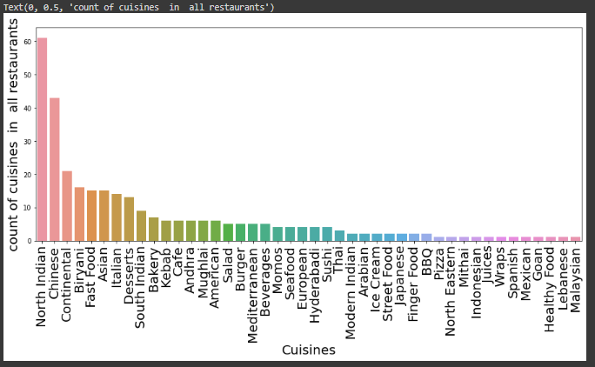
Cuisines offered by restaurants
We can see that 'North indian' is the Popular Cuisine which is offered by almost many resturants. And 'Malaysian' is the rare cuisine.

Slide 7
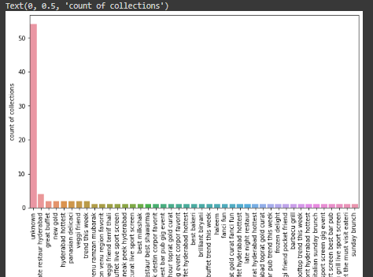
Collections offered by restaurants
We can see that, the maximum collections are null values as we defined it unkonown earlier.

Slide 8
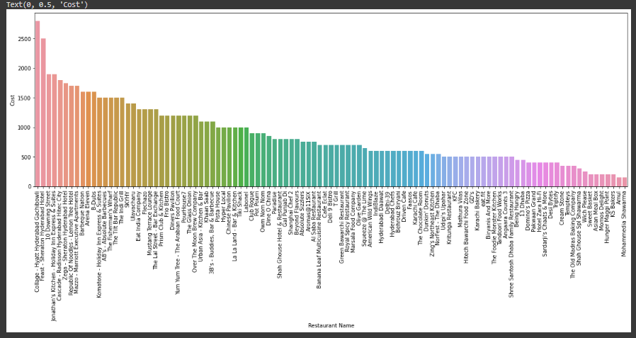
Average Cost of each restaurant
We can see that Collage - Hyatt Hyderabad Gachibowli is the most expensive restaurant

Slide 9
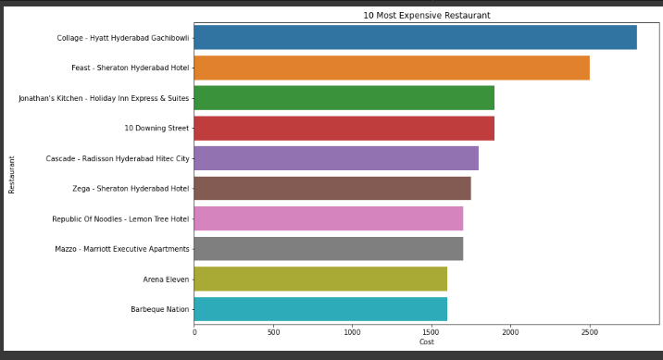
Top 10 Most Expensive Restaurants
From above analysis we can see most Expensive Restaurant as per rateing and cost are collage-hyatt Hyderabad gachbowl

Slide 10
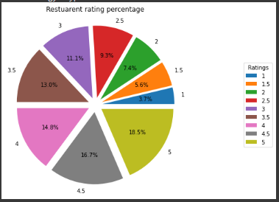
Restaurants available wrt different Ratings
We can see that majority of the restuarants has >3 rating.

Slide 11
Clustering
Clustering or cluster analysis is a machine learning technique, which groups the unlabelled dataset. It can be defined as "A way of grouping the data points into different clusters, consisting of similar data points. The objects with the possible similarities remain in a group that has less or no similarities with another group.“
It does it by finding some similar patterns in the unlabelled dataset such as shape, size, color, behavior, etc., and divides them as per the presence and absence of those similar patterns.
It is an unsupervised learning method, hence no supervision is provided to the algorithm, and it deals with the unlabeled dataset.
After applying this clustering technique, each cluster or group is provided with a cluster-ID. ML system can use this id to simplify the processing of large and complex datasets.

Slide 12
Agglomerative Hierarchical Clustering
Also known as bottom-up approach or hierarchical agglomerative clustering (HAC). A structure that is more informative than the unstructured set of clusters returned by flat clustering. This clustering algorithm does not require us to prespecify the number of clusters. Bottom-up algorithms treat each data as a singleton cluster at the outset and then successively agglomerates pairs of clusters until all clusters have been merged into a single cluster that contains all data.

Slide 13
DBSCAN clustering
K-Means clustering may cluster loosely related observations together. Every observation becomes a part of some cluster eventually, even if the observations are scattered far away in the vector space. Since clusters depend on the mean value of cluster elements, each data point plays a role in forming the clusters. A slight change in data points might affect the clustering outcome. This problem is greatly reduced in DBSCAN due to the way clusters are formed. This is usually not a big problem unless we come across some odd shape data.

Slide 14
K Means Clustering
K-Means Clustering is an Unsupervised Learning algorithm , which groups the unlabeled dataset into different clusters. Here K defines the number of pre-defined clusters that need to be created in the process, as if K=2, there will be two clusters, and for K=3, there will be three clusters, and so on.
It is an iterative algorithm that divides the unlabeled dataset into k different clusters in such a way that each dataset belongs only one group that has similar properties.

Slide 15
Elbow method
The elbow method runs k-means clustering on the dataset for a range of values for k (say from 1-10) and then for each value of k computes an average score for all clusters. By default, the distortion score is computed, the sum of square distances from each point to its assigned center.

Slide 16
Mini-batch k-means
Mini Batch K-means algorithm‘s main idea is to use small random batches of data of a fixed size, so they can be stored in memory. Each iteration a new random sample from the dataset is obtained and used to update the clusters and this is repeated until convergence

Slide 17
Validation
Clustering is the task of dividing the population or data points into a number of groups such that data points in the same groups are more similar to other data points in the same group and dissimilar to the data points in other groups. It is basically a collection of objects on the basis of similarity and dissimilarity between them.
A variety of measures have been proposed in the literature for evaluating clustering results. The term clustering validation is used to design the procedure of evaluating the results of a clustering algorithm.

Slide 18
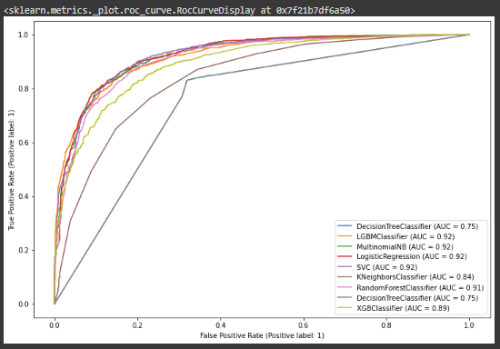
Models
Evaluation - ROC curve
Models
According to the above ROC curve, LGBM, Multinomial NB and Logistic regression are performing good.

Slide 19
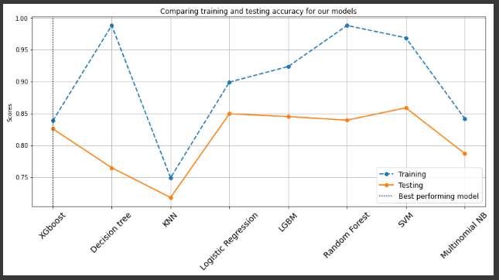
Models to choose for Hyper-parameter tuning
We can see that our models are quite overfitting. But if we consider those models with less overfitting and more than 80% accuracy then it would be
(1)XGboost
(2) Logistic regression
(3) LGBM and
(4) SVM
Now we do the hyperparameter tuning for these models and we choose the best amongst these.

Slide 20
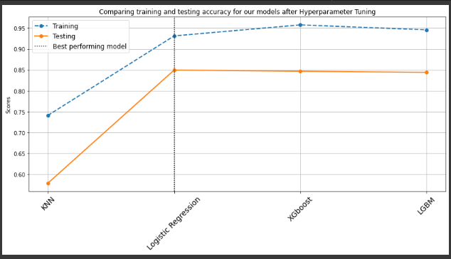
Conclusion
That's it! We reached the end of our exercise. Starting with loading the data so far we have done EDA, null values treatment, encoding of categorical columns, feature selection, and then model building.
From the above, We can see that Logistic regression model is working fine as compared to other models. Its accuracy and recall is maximum. Finally our conclusion is that the Logistic regression model is the best suitable model for this sentimental analysis of the project.

Slide 21
THANK YOU!

